Slide 1
Department of Computer Science & Engineering
UE17CS355 – Web Tech II Laboratory
Project Evaluation
Project Title : ONLINE SHAPPING
Project Team : SRN1201802415-Suma J
SRN1201802434-Shraddha
SRN1201802326-Aishwarya

Slide 2
Project Description
Online shopping is a well-known company serving Indians and others, with a variety of all products these include laptop, cloths, electricals ,ect
This project is that it is B2C E-Commerce site which means that online money transactions is taking place between consumer and business house.

Slide 3
Technologies Used
Front End: ANGULAR,HTML,CSS,JSON,XML
Back End: NODE.JS
DATABASE: MySQL.

Slide 4
Techniques Implemented
Angular cli
Drag and drop
multistage download
Restful api implementation

Slide 5
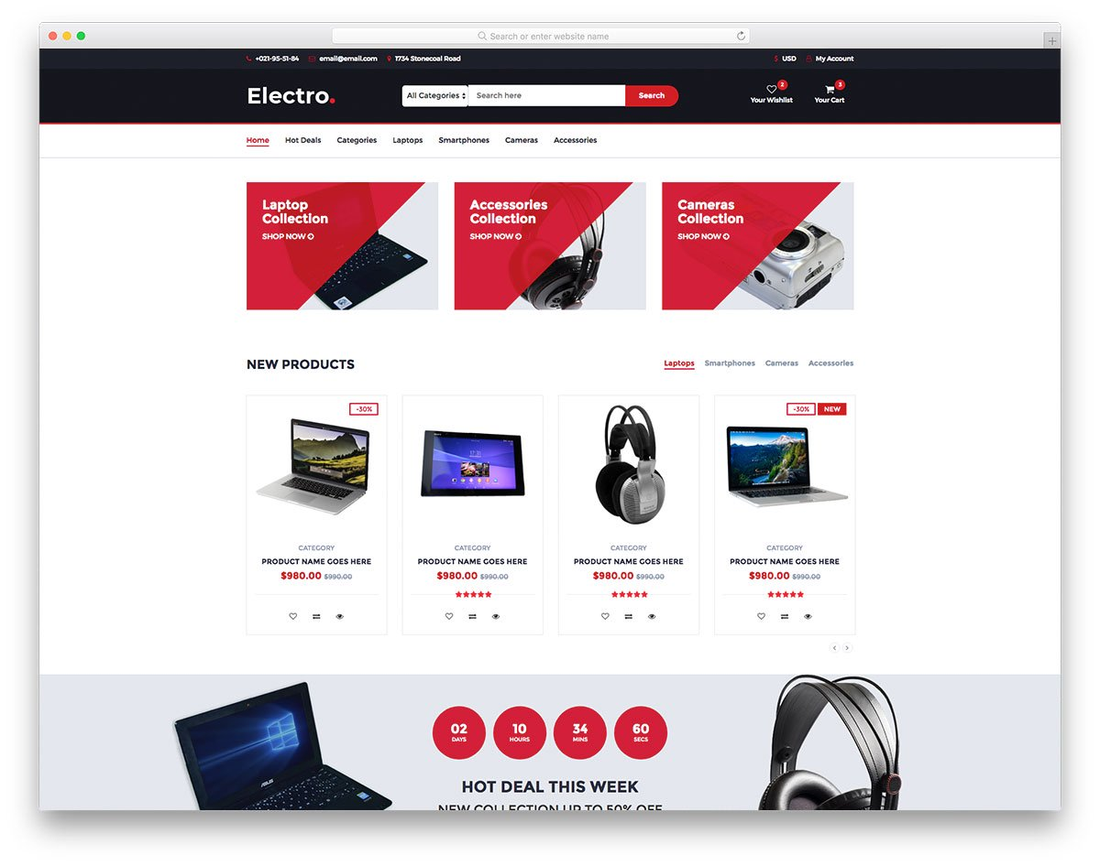
Intelligent Functionality
SUGGESTION
RATING

Slide 6
Thank You

